Slide 1

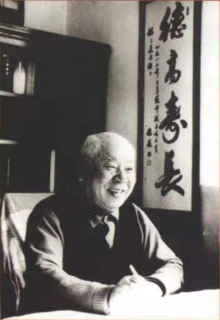
About Dr Yu Gu
Dr Yu Gu, BA, BSC, PhD, MBAcC, is a fully qualified acupuncturist, insured and accredited by the British Acupuncture Council. Yu is committed to working to professional guidelines and adhering to strict clinical hygiene standards.
Dr Yu Gu obtained the Bachelor’s degree in Medicine in 2000. She was awarded the Master Degree of Acupuncture in Chinese Medicine in 2003. Since then she moved to the UK and practiced in the Five Element Clinic. Yu achieved the PhD in Biomedical Sciences at the University of Aberdeen in 2007. In 2019, she achieved the second Bachelor’s degree after 3.5 years study and practice in the College of Integrated Chinese Medicine, UK.
Dr Yu Gu is the third generation of a traditional Chinese medicine family who practices TCM for more than a century. Grandfather (1904-2003) – Dr Mingsan Gu was a nationally reputable Chinese medicine herbalist who practiced until 95 years old. He was officially awarded as
About Dr Yu Gu
Dr Yu Gu’s father Dr Yanfang Gu inherited the wealth of knowledge from grandfather and has practiced more than 40 years with good reputation nationally. He has a wide range of expertise treating difficult conditions, and also specialised at treating cancer & renal patients.
As the 3rd generation of the TCM family, Yu is passionate about acupuncture. Yu has inherited the TCM knowledge and experience from her family, and has years of experience in the clinic. She enjoys treating a wide variety of patients and conditions using both TCM and Five Elements approaches to achieve the wellbeing of physical and mental levels.
Acupuncture
Tui Na (Chinese Therapeutic Massage)
Paediatric Therapeutic Massage
Dr Yu Gu
MD, BSc Hons, PhD, MBAcC
Fully qualified acupuncturist
insured and accredited by the
British Acupuncture Council
Practice Address:
Cyncoed Medical Centre
Dartington Drive
Cardiff
CF23 8SQ
Neal’s Yard Remedies
23-25 Morgan Arcade Cardiff CF10 1AF
Top 10 Distinguished TCM Doctors (十大名医) by Chinese Ministry of Health in 1991. His expertise was to treat a wide variety of difficult conditions including cancer, gynaecology, internal diseases etc.
Booking TEL: 07588812388
Email: DrGu.TCM@gmail.com

